Slide 1
Advanced C
Associative Containers in C++
Th.S Nguyen Minh Anh
Phenikaa University
Last Update: 23rd February 2023

Slide 2
Recap: Vector
Vector is good, and flexible
Fast random access but slow retrieval
What if

Slide 3
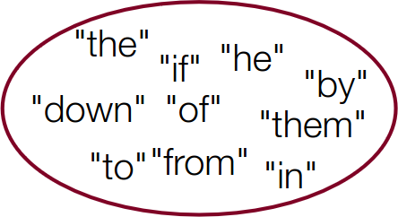
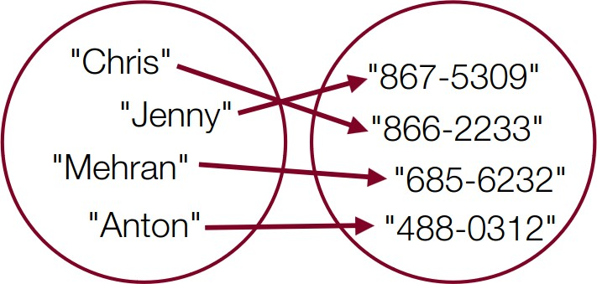
Sets and Maps
Sets
Maps
Collection of elements with no duplicates
Collection of key/value pairs
The key is used to find its associated value

Slide 4
Outline
Set
Maps
Multi-Sets & Multi-Maps

Slide 5
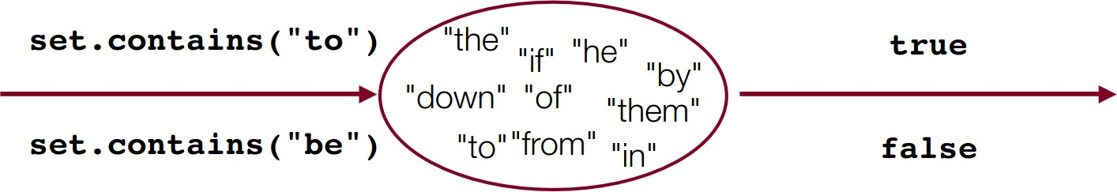
Set
Set
A collection of elements with no duplicates.
Operations include add, contains, and remove, and they are all fast
Sets do not have indexes

Slide 6
Sets: Simple Example
Set<string> friends;
friends.add("chris"); friends.add("anton");
cout << friends.contains("voldemort") << endl;
for(string person : friends) { cout << person << endl;
}

Slide 7
Set Essentials
int set.size()
Returns the number of elements in the set.
void set.add(value)
Adds the new value to the set (ignores it if the value is already in the set)
bool set.contains(value)
Returns true if the value is in the set, false otherwise.
void set.remove(value)
Removes the value if present in the set. Does not return the value.
bool set.isEmpty()
Returns true if the set is empty, false otherwise.
Sets also have other helpful methods. See the online docs for more.

Slide 8
Looping Over a Set
for(type currElem : set) {
// process elements one at a time
}
can’t use a normal for loop and get each element[i]
for(int i=0; i < set.size(); i++) {
// does not work, no index! cout << set[i];
}

Slide 9


Types of Sets
Set
HashSet
Iterate over elements in sorted order
O(log n) per retrieval
Implemented using a ”binary search tree”
Iterate over elements in unsorted order
O(1) per retrieval
Implemented using a ”hash table”

Slide 10
Set Operands
Sets can be compared, combined, etc.
s1 == s2
true if the sets contain exactly the same elements
s1 != s2
true if the sets don’t contain the same elements
s1 + s2
returns the union of s1 and s2 (all elements in both)
s1 * s2
returns intersection of s1 and s2 (elements must be)
s1 - s2
returns difference of s1, s2 (elements in s1 but not s2)

Slide 11
Exercise
Count Unique Words

Slide 12
Outline
Set
Maps
Multi-Sets & Multi-Maps

Slide 13
Maps
Map
A collection of pairs (k, v), sometimes called key/value pairs, where v can be found quickly if you know k.
a.k.a. dictionary, associative array, hash
A generalization of an array, where the ”indexes” need not be ints.

Slide 14
Using Maps
A map allows you to get from one half of a pair to the other.
Store an association from ”Jenny” to ”867-5309”
Get Jenny’s number

Slide 15
Maps are Everywhere
Wiki: key = title, value = article
Dictionary: key = word, value = meaning

Slide 16
Creating Maps
Requires 2 type parameters: one for keys, one for values.
// maps from string keys to integer values
Map<string, int> votes;
// maps from double keys to Vector<int> values Map<string, Vector<string>> friendMap;

Slide 17
Map Methods
m.clear()
m.contains()
m[key]
m.empty()
m[key] = value or m.insert(pair(key,value))
m.erase(key)
m.size()

Slide 18
Map Example

Slide 19
Types of Maps
Map
HashMap
Iterate over elements in sorted order
O(log n) per retrieval
Implemented using a ”binary search tree”
Iterate over elements in unsorted order
O(1) per retrieval
Implemented using a ”hash table”

Slide 20
Map Example: Tallying Votes

Slide 21
Tallying Words

Slide 22
Looping Over a Map
Map<string, double> gpa = load();
for (string name : gpa) {
cout << name << "’s GPA is "; cout << gpa[name] << endl;
}
*The order is unpredictable in a HashMap

Slide 23
Outline
Set
Maps
Multi-Sets & Multi-Maps

Slide 24
Multi what?

